Slide 1
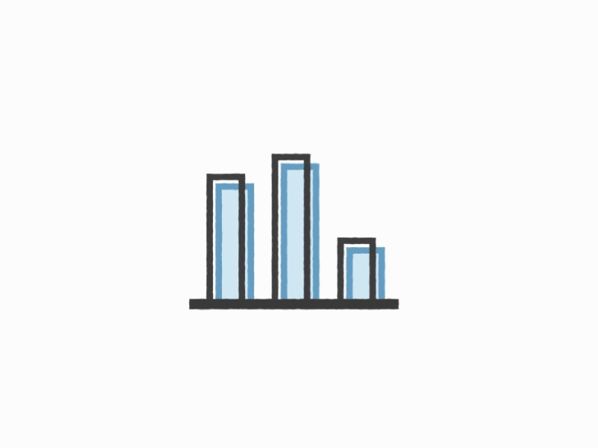
Student Stress Level Calculator and Coping Mechanisms
Anagha Vasista
Pujitha Sai Tulasi Muddhu
Tarun Nagasiddappa Somashekar
Yasha Mahesh Bhat

Slide 2

Contents
Introduction
Problem Statement
Literature Survey
Timeline
Concept Map
Implementation
Results
Inference
Conclusion
Future Scope
References

Slide 3

Introduction
The pursuit of higher education on an international scale offers a myriad of opportunities for personal and academic growth yet introduces a set of unique challenges.
The transformative journey of pursuing advanced degrees in foreign environments often brings forth a confluence of factors that contribute to heightened stress levels.

Slide 4

Problem Statement
Our project aims to delve into the multifaceted reasons behind the stress experienced by international graduate students, shedding light on the interplay of academic, cultural, and personal factors that shape their well-being during this pivotal phase of their lives.
Understanding these stressors is crucial for institutions, educators, and support services to develop effective strategies that foster a nurturing and conducive environment

Slide 5

Literature Survey
‘Risk factors associated with stress, anxiety, and depression among university undergraduate students’ by Mohammad Mofatteh, AIMS Public Health. 2021; Published online 2020 Dec 25. doi: 10.3934/publichealth.2021004 PMCID: PMC7870388 ; PMID: 33575406
This review assessed 41 articles from 2000 to 2020, investigating stress, anxiety, and depression risk factors among university undergraduates in developed and developing countries. Six major themes emerged: psychological, academic, biological, lifestyle, social, and financial. Identifying these factors early is crucial for providing timely mental health support and preventing exacerbation. The study emphasizes the need for proactive strategies to address diverse challenges faced by students from various backgrounds.
‘Academic Stress and Mental Well-Being in College Students: Correlations, Affected Groups, and COVID-19,’ by Georgia Barbayannis, Mahindra Bandari, Xiang Zheng, Humberto Baquerizo, Keith W. Pecor, Xue Ming1, Front. Psychol., 23 May 2022, Sec. Educational Psychology, Volume 13 – 2022
The study surveyed 843 college students, finding a significant correlation between increased academic stress and poorer mental well-being, exacerbated by the COVID-19 pandemic. Non-binary individuals had the lowest mental health and highest academic stress, while men showed the opposite trend. Women and non-binary students reported higher academic stress. The results emphasize the need for targeted support, especially for vulnerable student groups facing heightened academic stress.

Slide 6
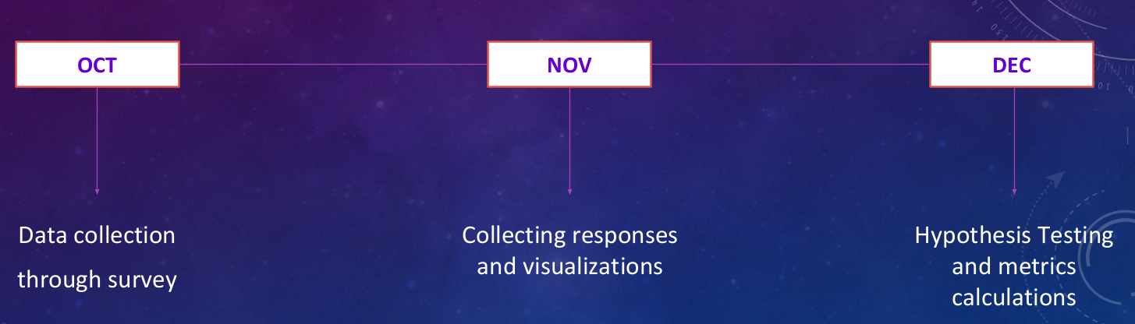
Project Timeline

Slide 7
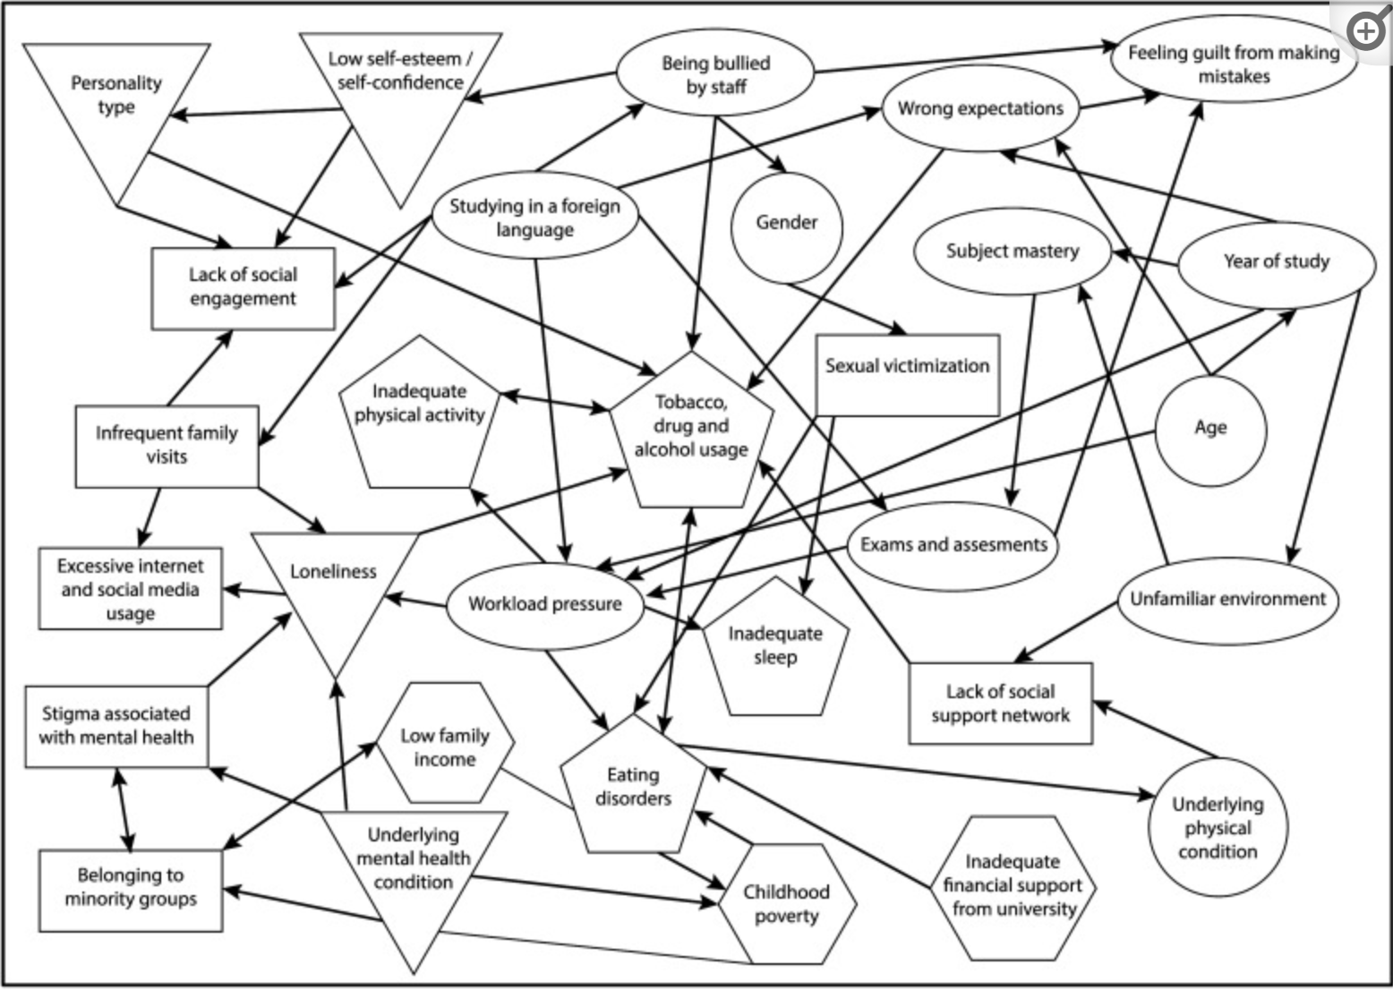
Concept Map

Slide 8

Implementation
The first step was to create a google survey form asking international graduate students at Northeastern University their stress factors.
It included choosing the various factors contributing to the stress of students.
The following questions were choosing as to at what frequency each of the sub-factors under each stress factor category affected the student

Slide 9
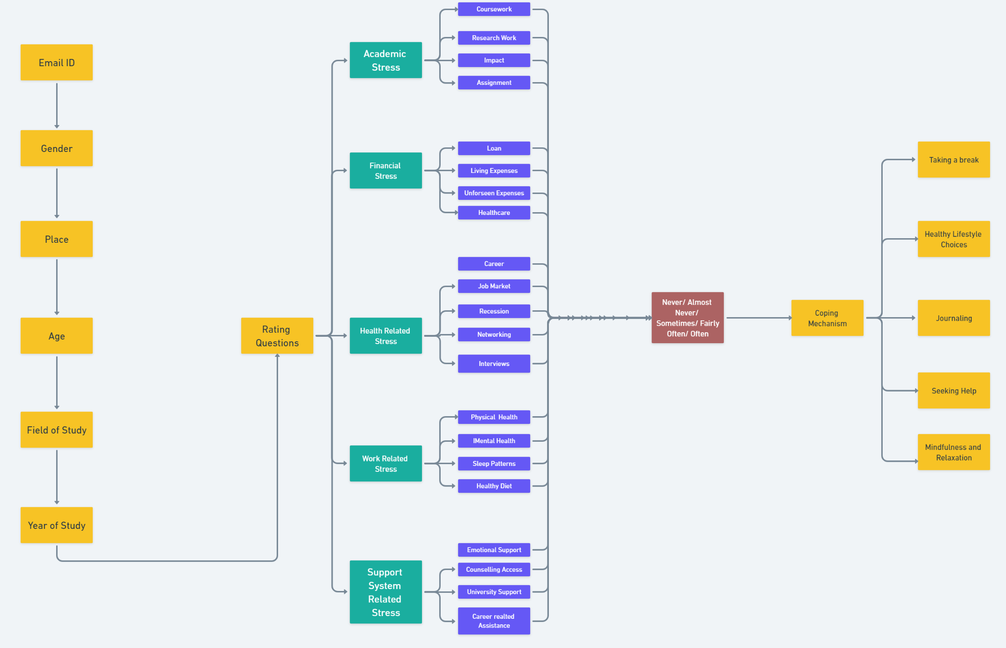
Implementation - Survey Form Design

Slide 10
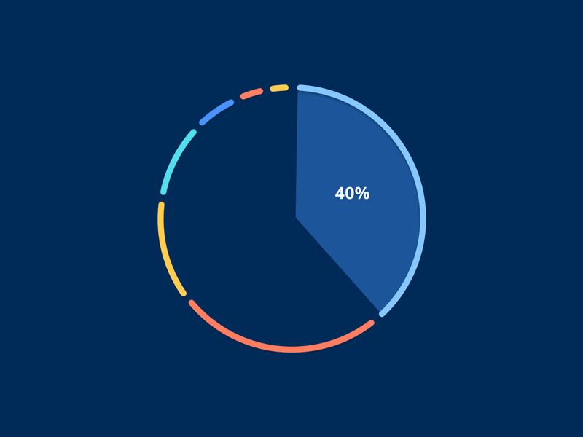
Implementation
We leverage google looker to generate certain graphs and charts to draw inferences.
The number of responses received is the sample size
Metrics like mean of various stress factors is calculated along with percentage distribution of various sub-factors, population proportion are calculated and comparing the mean levels among different stress levels is conducted

Slide 11
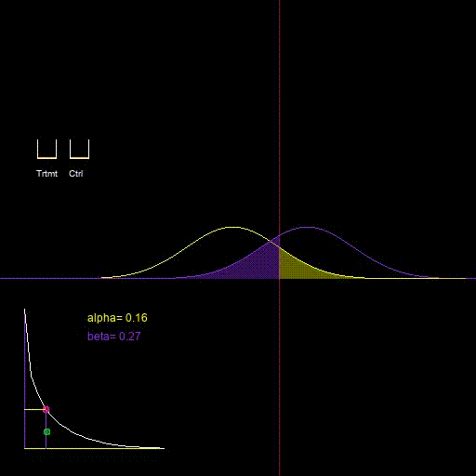
Implementation (Cont.)
There are population comparisons done for male to female stress ratio along with stress levels of first and second students’ stress levels
Charts are generated for various sub-factors for which students responded with frequency of their occurrence.

Slide 12
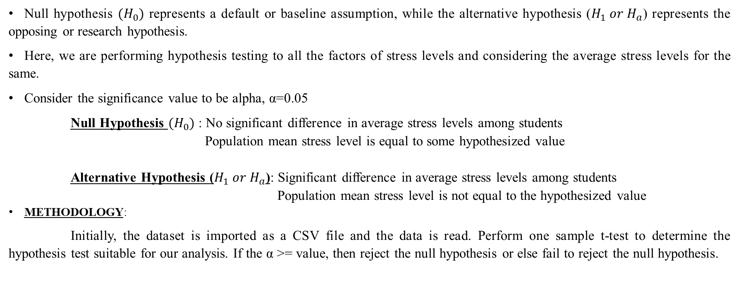
Implementation (Cont.)
Null hypothesis ${(H}_{0})$ represents a default or baseline assumption, while the alternative hypothesis ($H_{1} or H_{a}$) represents the opposing or research hypothesis.
Here, we are performing hypothesis testing to all the factors of stress levels and considering the average stress levels for the same.
Consider the significance value to be alpha, α=0.05
Null Hypothesis ${(H}_{0})$ : No significant difference in average stress levels among students
Population mean stress level is equal to some hypothesized value
Alternative Hypothesis ($H_{1} or H_{a}$): Significant difference in average stress levels among students
Population mean stress level is not equal to the hypothesized value
METHODOLOGY:
Initially, the dataset is imported as a CSV file and the data is read. Perform one sample t-test to determine the hypothesis test suitable for our analysis. If the α >= value, then reject the null hypothesis or else fail to reject the null hypothesis.

Slide 13
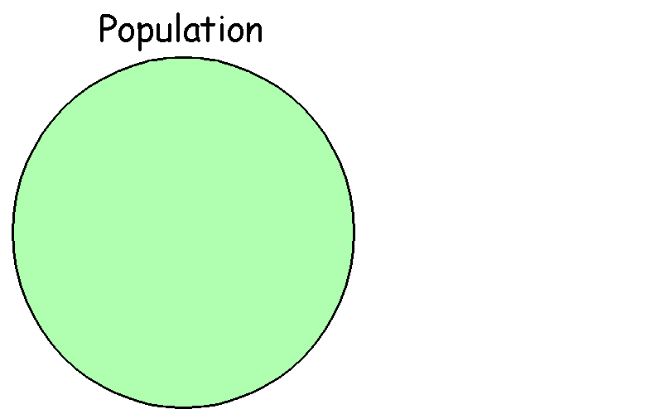
Results
What is the mean of a variable?
The variables under consideration for mean calculation are as follows:
Academic stress: 3.26
Financial stress: 3.73
Health related stress: 2.74
Work related stress: 3.21
Support system related stress: 2.96
How do the two means compare?
To compare the two means, we are considering two populations that that is first year and second year students for financial stress.
From the data obtained from the dashboard, the mean stress levels for the above population are as follows:
I year students: 3.94
II year students: 3.35

Slide 14
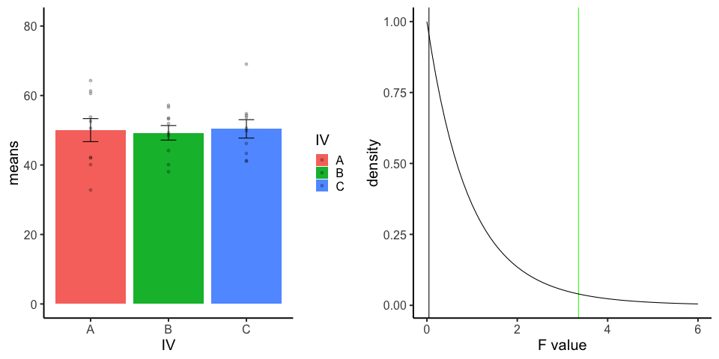
Results
3) What is the proportion of a population that has a certain characteristic?
We examine the incidence of support system-related stress among the female population. Out of 41 female students surveyed, 18 students (43.9%) reported encountering stress related to the support system.
4) How do the proportions of two populations having a certain characteristic compare?
The proportions of the two populations that we consider here are male and female. To compare, we consider financial stress among male and female population. Out of 61 male students, 32(52.5%) and out of 41 female students, 18 (43.9%) students experience stress due to student loans.
Thus, we can conclude that male population face higher stress levels due to student loans compared to the female population.

Slide 15
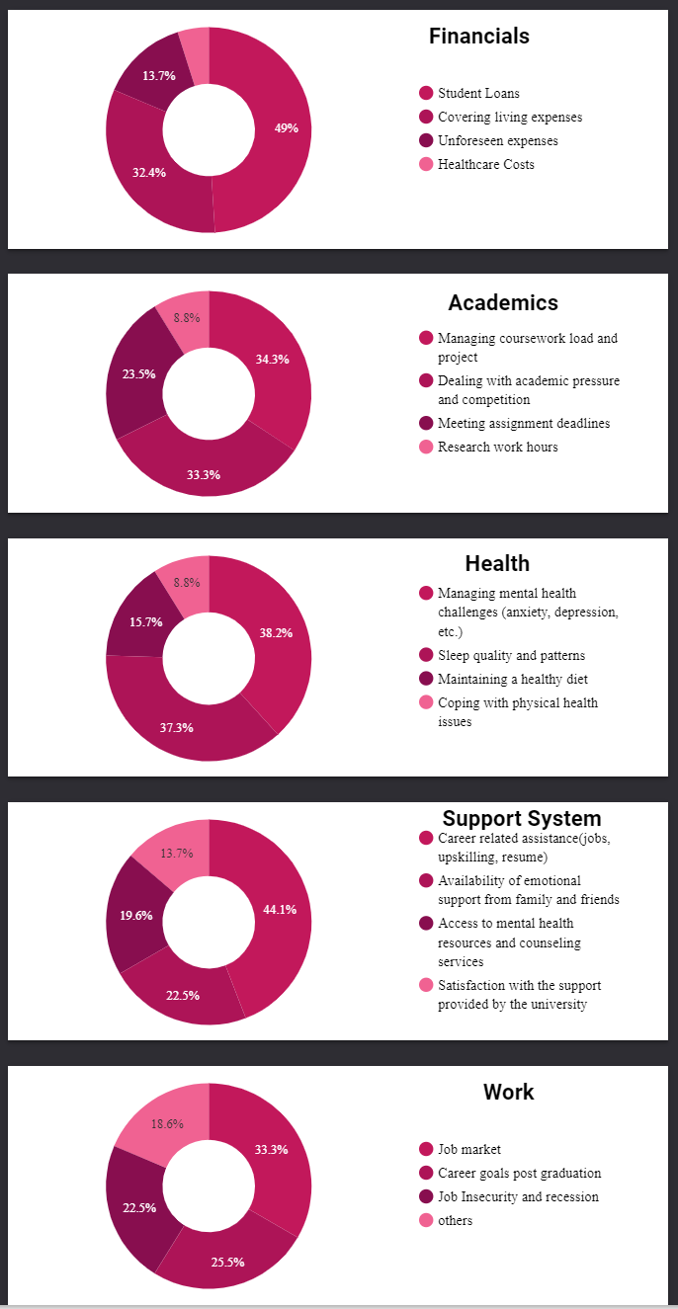
Inference
From the mean values calculated, it can be seen that financial stress is the highest followed by academic and work
The major financial stress is due to loan availed, academic due to coursework load, work due to the job market to read a few

Slide 16
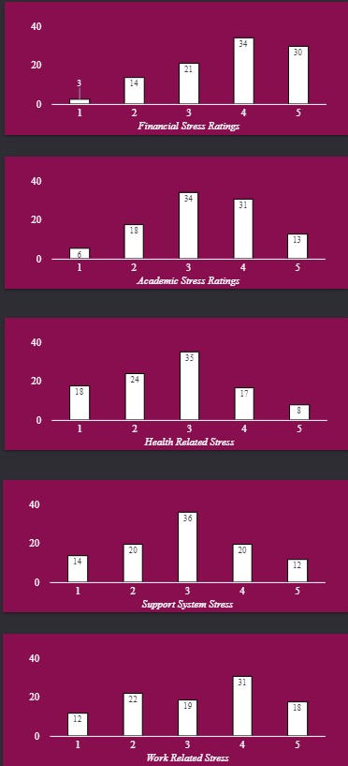
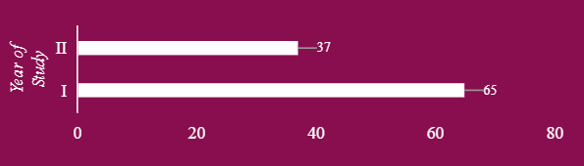
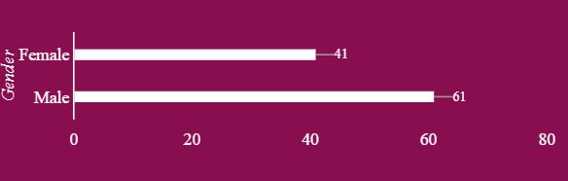
Inference(Cont.)
The histogram obtained shows the least to most opted frequency of sub-stress factors
The charts also show that first year students and male graduate students have a higher stress level

Slide 17
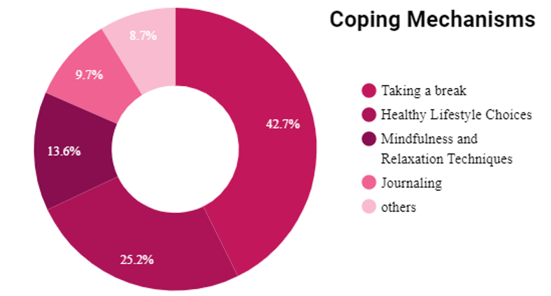
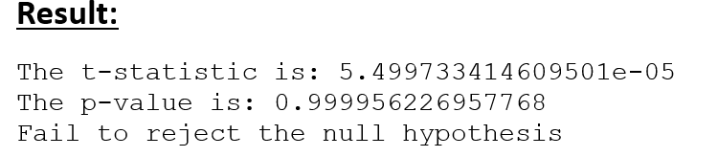
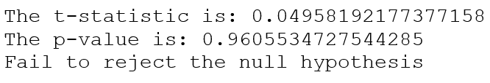
Inference (Cont.)
The coping mechanism most common is taking a break, with adapting healthy lifestyles being second and if followed by practicing mindfulness
Hypothesis testing for each stress level indicates that the null hypothesis cannot be rejected which further implies that there is no significant difference in the academic and financial stress levels among the students

Slide 18
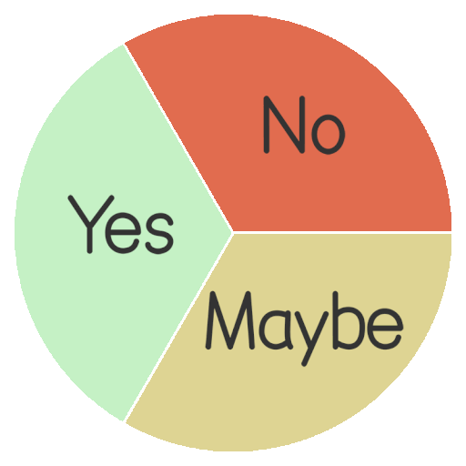
Conclusion
Based on the data collected and graphs produced, the university and other organizations can implement necessary steps to better the student experience
The math involved here not only is theoretical but can be used to bring about positive changes contributing to growth

Slide 19

Future Scope
The data collected can be further scrutinized to see how various factors affect different year students
Also the effect of each factor on another one can be determined
Hypothesis testing can be performed to check the stress levels of students from different courses as well incase of a larger and clean sample set

Slide 20
References
https://www.mdpi.com/2076-0760/12/6/318
https://www.insidehighered.com/news/student-success/health-wellness/2023/05/23/survey-stress-hurting-college-students
https://disorientation.nu/2017/mental-health-at-northeastern/
https://www.definitivelogic.com/insights/2021/increasing-data-literacy/

